Slide 1

Department of Cyber Security
Dual Layer Steganography with LSB and AES Algorithms for Enhanced Security and Secure
Under the Guidance of,
_{Mr. P. Srinivasa Rao M.Tech.}
Department of Cyber Security,
Narasaraopeta Engineering College (Autonomous),
Narasaraopet- 522 601.
PRESENTED BY
JAMPANA AAMUKTHA (22471A4618)
ASUKOLLA SIVA NAGARAJU (22471A4623)
KOLAKALURI INAK (22471A4625)

Slide 2
OUTLINE
Abstract
Introduction
Literature Survey
Research Gaps
Problem Statement
Objectives
Block Diagram / Flow Diagram
Methodology
Implementation
Results and Analysis
Conclusion & Future Scope
References
Question and Answers

Slide 3
ABSTRACT
A Dual Layer Steganography System, which combines AES encryption with image steganography techniques (LSB and DCT). The system first encrypts the message using AES-GCM and then hides the encrypted data inside an image, making the communication both secure and invisi- ble.This approach ensures confidentiality, integrity, and stealth, making it highly suitable for secure communication applications.The use of dual-layer security en- sures that even if the hidden data is detected, it remains protected due to encryption. Additionally, the system incorporates a SHA-256 based authentication mechanism to verify data integrity and detect any tampering attempts. The encrypted data is then embedded into a digital image using steganographic techniques such as Least Significant Bit (LSB) and Discrete Cosine Transform (DCT).This combination of encryption, authentication, and data hiding provides a robust and secure commu- nication framework.Furthermore, the system is implemented using Python with li- braries such as OpenCV, PIL, and Cryptography, and includes a user-friendly graphical interface that allows users to easily encrypt, embed, extract, and decrypt messages.

Slide 4
INTRODUCTION
1. Brief Introduction to the Project
The rapid growth of digital communication has increased the need for secure data transmission systems. Sensitive information such as personal messages, financial data, and confidential files are frequently exchanged over the internet, making them vulnerable to cyber attacks. Traditional security methods like encryption alone are not always sufficient, as encrypted data can still attract attackers
2. Motivation behind the Project
The motivation behind this project arises from the need to develop a more intelligent, adaptive, and efficient system for detecting anomalies in network traffic. Machine learning offers a promising solution by enabling systems to learn patterns from data and identify unusual behaviour without relying solely on predefined rules. By leveraging machine learning techniques, it is possible to detect both known and unknown attacks with higher accuracy and reduced human intervention

Slide 5
3. Importance and Relevance
In today’s digital world, network security is very important due to the increasing number of cyberattacks and data breaches. Organizations depend on secure networks to protect sensitive information and maintain smooth operations. Traditional security systems often fail to detect new or unknown attacks and may generate high false alarms.
The proposed Hybrid Network Anomaly Detection System is important because it provides a smart and efficient solution for detecting network threats. By combining rule-based detection with machine learning, the system improves accuracy, detects both known and unknown attacks, and reduces false positives. Its ability to work in real-time and provide quick responses makes it highly relevant for modern cybersecurity needs in organizations, enterprises, and research environments.

Slide 6
LITERATURE SURVEY
S . No | Research Work / Journal | Research Outcome | Research Gap
1. | AES Standard (NIST) | AES provides strong encryption ensuring high data confidentiality and is widely used for secure communication. | Encryption alone does not hide the presence of data, making it vulnerable to detection and targeted attacks.
2. | Cryptography and Network Security – William Stallings | Highlights importance of encryption and hashing techniques for secure data transmission. | Focuses mainly on cryptography and lacks integration with data hiding techniques like steganography.

Slide 7
LITERATURE SURVEY
S . No | Research Work / Journal | Research Outcome | Research Gap
3. | Digital Image Steganography – Neal Krawetz | Demonstrates effective methods for hiding data within images without noticeable changes. | Lacks strong encryption, making hidden data vulnerable if detected
4. | IEEE Research Papers on Steganography) | Provide advanced techniques combining spatial and frequency domain methods for better security. | Many methods lack proper authentication mechanisms and are not user-friendly for real-time applications.

Slide 8
LITERATURE SURVEY
S . No | Research Work / Journal | Research Outcome | Research Gap
5. | OpenCV Documentation | Offers efficient tools for image processing and implementation of steganography techniques. | Does not provide built-in security features like encryption or authentication, requiring external integration.

Slide 9
RESEARCH GAPS
The proposed Dual Layer Stegnography System is designed to overcome the limitations identified in existing research works. The following points explain how the project addresses each research gap:
• Gap 1: Lack of Dual-Layer Security
Challenge: Existing systems use either encryption or steganography, not both together. Solution: Combine AES encryption with LSB/DCT steganography for enhanced security
• Gap 2: Absence of Data Integrity Verification
Challenge: Many systems do not detect data tampering during transmission. Solution: Use SHA-256 hashing to ensure data integrity and authenticity.

Slide 10
RESEARCH GAPS
• Gap 3: Low Robustness Against Attacks
Challenge: Traditional LSB methods are vulnerable to compression and image processing. Solution: Integrate DCT-based embedding to improve robustness.
.
• Gap 4 : Limited Flexibility in Techniques
Challenge: Systems rely on a single embedding method. Solution: Provide both LSB and DCT options for better adaptability.
• Gap 5: Poor User Accessibility
Challenge: Many systems lack user-friendly interfaces. Solution: Develop a GUI-based system for easy interaction and usability.

Slide 11
RESEARCH GAPS
The proposed system effectively addresses major research gaps by providing a hybrid, efficient, and real-time anomaly detection solution. It improves accuracy, reduces false positives, and ensures scalability, making it more suitable for practical network security applications compared to existing methods.

Slide 12
PROBLEM STATEMENT
With the increasing use of digital communication, protecting sensitive information has become a major challenge. Existing systems primarily rely on either encryption or steganography, but not both. Encryption techniques secure the data by converting it into an unreadable format; however, the presence of encrypted data itself can attract attackers. On the other hand, steganography hides data within images or other media, but if the hidden data is detected, it can be easily extracted due to the lack of strong encryption.
Another major issue with existing systems is the absence of proper data integrity mechanisms. Many systems do not verify whether the data has been modified during transmission, making them vulnerable to tampering and unauthorized access.

Slide 13
OBJECTIVES
The primary objective of this project is to develop a secure Dual Layer Steganography system that ensures safe and hidden transmission of sensitive information.
The system aims to combine cryptography and steganography techniques to provide enhanced security compared to traditional single-layer approaches.
By encrypting the message using AES before embedding it into an image, system ensures that the data remains protected even if it is detected.
Another objective is to ensure data integrity and reliability by incorporating SHA-256 based authentication. The overall goal is to create an efficient, secure, and practical solution for real-world applications such as secure communication, data protection, and digital watermarking.

Slide 14
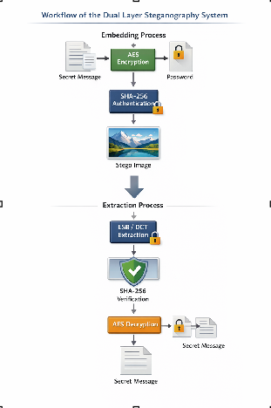
BLOCK DIAGRAM AND FLOW CHART
This flowchart illustrates theDual layer stegnography used in
the system.
KEY STEPS:
Secret Message
Image Selection
SHA-256 Authentication
Encryption using ( LSB + AES )
BENEFITS:
Provides dual-layer security
Hides data without visible changes.
Low cost using open-source tools.

Slide 15
METHODOLOGY
The methodology of the proposed Dual Layer Steganography system follows a systematic approach to ensure secure data transmission through encryption and data hiding techniques
The process begins with user input, where the plaintext message, password, and cover image are provided through a graphical user interface. The message is first encrypted using the AES algorithm, and a secure key is generated from the password using SHA-256 hashing to ensure confidentiality.
After encryption, the system generates a SHA-256 hash of the encrypted data to maintain data integrity. The encrypted message along with the hash is structured and converted into binary format.
This binary data is then embedded into the selected image using either LSB (spatial domain) or DCT (frequency domain) steganography techniques.

Slide 16
METHODOLOGY
Framework Used:
• Cryptography Library – Implements AES encryption and decryption
• Python – The primary programming language used for implementing the system, handling data processing, and integrating all modules.
• NumPy – Used for data manipulation, cleaning, and efficient numerical computations during preprocessing and analysis.
OpenCV – Handles image processing and DCT operations
Pillow (PIL) – Used for image loading, editing, and saving
• Tkinter – Provides graphical user interface for user interaction

Slide 17
METHODOLOGY
Algorithms:
AES (Advanced Encryption Standard)
AES is used for encrypting the plaintext message into ciphertext before embedding. It ensures strong data security by using a secret key generated from the user’s password. This prevents unauthorized access to the hidden data even if it is extracted.
LSB (Least Significant Bit) Steganography
LSB is a spatial domain technique used to embed encrypted data into the least significant bits of image pixels. It provides high embedding capacity and fast processing while maintaining the visual quality of the image.

Slide 18
METHODOLOGY
Tools Used
• Python – Main programming language used for developing the system and implementing detection logic.
• VS Code / Jupiter Notebook – Used for coding, testing, and experimentation during development.
• OpenCV – Used for image processing and handling image data
• NumPy – Used for data cleaning, manipulation, and numerical computations.
• Cryptography Library – Used for implementing AES encryption and decryption
• Pillow (PIL) – Used for image manipulation and format handling
Tkinter – Used for designing the graphical user interface

Slide 19
METHODOLOGY
Parameter Settings (in Table Form)
Rule-Based Parameters
Parameter | Description
Encryption Algorithm | AES-GCM (256-bit key)
Hash Function | SHA-256
Key Generation | Password-based (SHA-256 derived key)
Embedding Techniques | LSB and DCT

Slide 20
METHODOLOGY
Random Forest Algorithm Parameters
Parameter | Description
Key Size | 256-bit
Nonce | 12 bytes (random)
Mode | Galois/Counter Mode
Hash Length | 256-bit output
Capacity | High (depends on image size)
Embedding Bits | 1 bit per channel (RGB)

Slide 21
IMPLEMENTATION
Programming Language
• Python – Main programming language used for developing the system and implementing detection logic.
• VS Code / Jupiter Notebook – Used for coding, testing, and experimentation during development.
• OpenCV – Used for image processing and handling image data
• NumPy – Used for data cleaning, manipulation, and numerical computations.
• Cryptography Library – Used for implementing AES encryption and decryption
• Pillow (PIL) – Used for image manipulation and format handling
Tkinter – Used for designing the graphical user interface

Slide 22
IMPLEMENTATION
Hardware Implementation
Required Hardware
Minimum Configuration:
Processor: Intel Core i3 or equivalent
RAM: 4 GB
Storage: 2 GB free space
Recommended Configuration:
Processor: Intel Core i5/i7 or equivalent
RAM: 8 GB or higher
Storage: SSD preferred for faster processing

Slide 23
IMPLEMENTATION
Hardware Integration
The hardware integration of the proposed Dual Layer Steganography system involves the coordination between system components such as the processor, memory, storage, and display to ensure smooth execution of all operations.
• The system is designed to run on standard computing devices where the CPU handles encryption, hashing, and steganography processes, while the RAM supports temporary data processing during embedding and extraction.
• The integration ensures that image processing operations using OpenCV, NumPy, and PIL are efficiently executed using system memory without overloading resources.

Slide 24
IMPLEMENTATION
CHALLENGES FACED
Data Security Risks
Challenge: Sensitive data may be exposed if encryption is weak or compromised. Solution: Implemented AES encryption with strong key generation using SHA-256 for enhanced security.
Limited Embedding Capacity
Challenge: Small images may not have sufficient space to hide large amounts of data. Solution: Used optimized LSB and DCT techniques and selected appropriate image sizes for better capacity.
Image Quality Degradation
Challenge: Embedding data can distort the image and reduce visual quality. Solution: Modified only least significant bits and mid-frequency coefficients to maintain image quality.

Slide 25
IMPLEMENTATION
CHALLENGES FACED
Vulnerability to Attacks
Challenge: Hidden data may be detected or removed through compression or image processing. Solution: Applied DCT-based embedding to improve robustness against compression and attacks.
Incorrect Password Handling
Challenge: Wrong password may lead to failed decryption or data loss. Solution: Used SHA-256 verification to validate data integrity before decryption.

Slide 26
IMPLEMENTATION
1.Data Input
Process: User provides plaintext message, password, and selects a cover image through the GUI.
2.Encryption
Process: The plaintext message is encrypted using AES with a key generated from the password using SHA-256.
3.Authentication
Process: A SHA-256 hash is generated and appended to the encrypted data to ensure integrity.
4.Data Embedding
Process: The encrypted data is embedded into the image using LSB or DCT steganography techniques.
5.Stego Image Generation
Process: The modified image is saved as a stego image containing hidden data.
6.Data Extraction
Process: The hidden data is extracted from the stego image using the selected method (LSB/DCT).
7.Verification & Decryption
Process: The extracted data is verified using SHA-256 and decrypted using AES to obtain the original message.

Slide 27
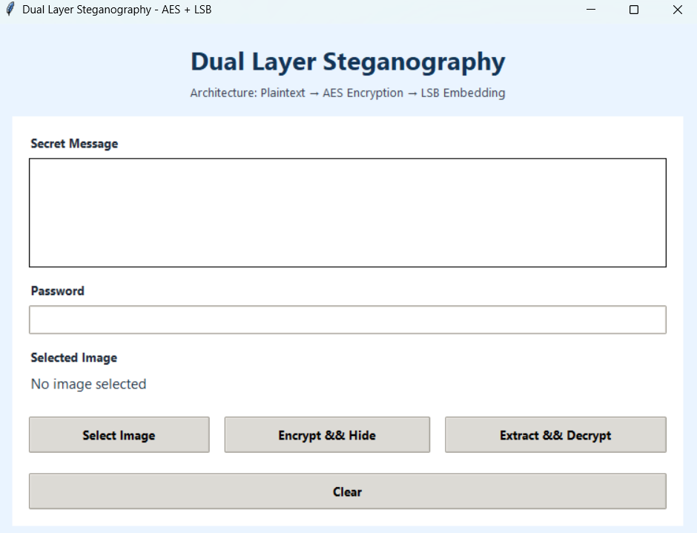
RESULTS & ANALYSIS
Before Encryption
Before encryption, the input data is in its original plaintext form, which is easily readable and understandable. At this stage, the message is vulnerable to unauthorized access, interception, and tampering if transmitted directly over a network. This highlights the need for applying encryption techniques to secure the data before embedding it into the image.

Slide 28
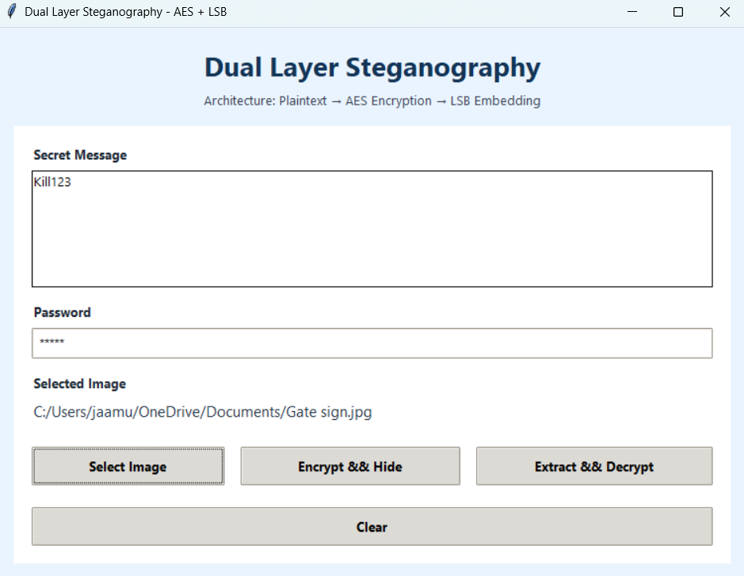
RESULTS & ANALYSIS
After EncryptionAfter encryption, the plaintext message is converted into ciphertext using the AES algorithm. The encrypted data appears as unreadable and random characters, ensuring that even if the data is accessed, it cannot be understood without the correct key. This stage enhances the confidentiality of the data and prepares it for secure embedding using steganography techniques.

Slide 29
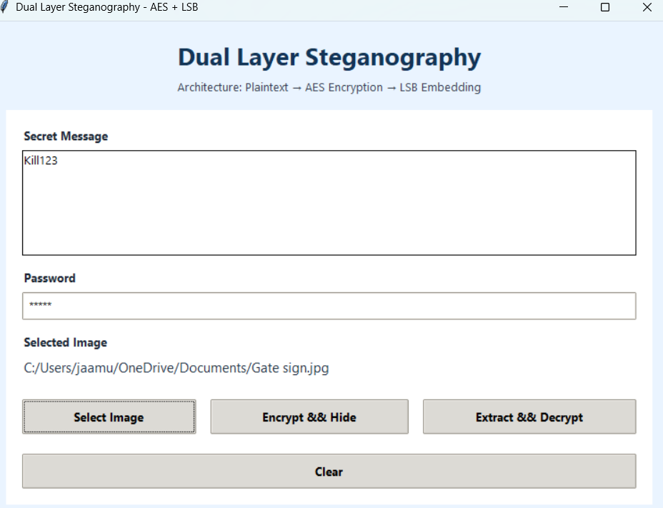
RESULTS & ANALYSIS
After Decryption
After decryption, the ciphertext is successfully converted back into the original plaintext message using the correct password. This demonstrates that the system accurately retrieves and reconstructs the hidden data without any loss or modification. The result confirms the effectiveness of the encryption and decryption process in maintaining data integrity and reliability.

Slide 30
CONCLUSION AND FUTURE SCOPE
The proposed Dual Layer Steganography system successfully combines AES encryption, SHA-256 authentication, and LSB/DCT techniques to provide secure and hidden data transmission. The system ensures confidentiality, integrity, and invisibility of data while maintaining good image quality and performance. It is efficient, user-friendly, and suitable for real-world secure communication applications
The system can be further enhanced by supporting video and audio steganography to increase capacity and security. Advanced techniques like DWT and AI-based optimization can be integrated to improve robustness against attacks. Additionally, developing a mobile or web-based version and adding multi-factor authentication can make the system more scalable and practical for modern applications.

Slide 31
REFERENCES
[1] NIST. "Specification for the Advanced Encryption Standard (AES)," FIPS PUB 197, 2001.
[2] National Institute of Standards and Technology (NIST), “Specification for the Advanced Encryption Standard (AES),” FIPS PUB 197, 2001.
[3] N. Provos and P. Honeyman, “Hide and Seek: An Introduction to Steganography,” IEEE Security & Privacy, vol. 1, no. 3, pp. 32–44, May–June 2003.
[4] W. Stallings, Cryptography and Network Security: Principles and Practice, 7th ed., Pearson, 2017.
[5] J. Zhang, M. Zulkernine, and A. Haque, “Random-Forest-Based Network Intrusion Detection Systems,” IEEE Transactions on Systems, Man, and Cybernetics, vol. 38, no. 5, pp. 649–659, 2008.
[6] A. Patcha and J. M. Park, “An Overview of Anomaly Detection Techniques: Existing Solutions and Latest Technological Trends,” Computer Networks, vol. 51, no. 12, pp. 3448–3470, 2007.

Slide 32
REFERENCES
[7] G. Creech and J. Hu, “A Semantic Approach to Host-Based Intrusion Detection Systems Using Contiguous and Discontiguous System Call Patterns,” IEEE Transactions on Computers, vol. 63, no. 4, pp. 807–819, 2014.
[8] N. Moustafa and J. Slay, “UNSW-NB15: A Comprehensive Data Set for Network Intrusion Detection Systems,” in Proc. MilCIS, 2015, pp. 1–6.
[9] S. Dua and X. Du, Data Mining and Machine Learning in Cybersecurity. Boca Raton, FL, USA: CRC Press, 2016.
[10] M. A. Ambusaidi et al., “Building an Intrusion Detection System Using a Filter-Based Feature Selection Algorithm,” IEEE Transactions on Computers, vol. 65, no. 10, pp. 2986–2998, 2016.
[11] H. Hindy et al., “A Taxonomy of Network Threats and the Effect of Current Datasets on Intrusion Detection Systems,” IEEE Access, vol. 8, pp. 104650–104675, 2020.

Slide 33
REFERENCES
[12] N. Johnson, Z. Duric, and S. Jajodia, Information Hiding: Steganography and Watermarking—Attacks and Countermeasures, Springer, 2000.
[13] B. G. Chandran and P. V. Nair, “A hybrid steganographic technique using discrete cosine transform and least significant bit insertion,” IJCSNS, vol. 8, no. 7,pp. 266–271, 2008.
[14] S. Umer et al., “Intrusion Detection Using Machine Learning Techniques: A Review,” Journal of Network and Computer Applications, vol. 42, pp. 1–17, 2017.
[15] K. Scarfone and P. Mell, “Guide to Intrusion Detection and Prevention Systems (IDPS),” NIST Special Publication, 2007.

Slide 34
QUESTIONS AND ANSWERS
Please ask questions if there are any doubts

Slide 35
THANK YOU

